Slide 1
Force Analysis Of Holonomic Wheels
Nex+Gen Griffin Robotics FTC Team 7582
Cameron Pase
Douglas Pase, dmpase@gmail.com

Slide 2
Bearing 0°
velocity 2
FL: -√2/2
FR: +√2/2
BR: +√2/2
BL: -√2/2
0°
315°
45°
270°
90°
-√2/2
+√2/2
FL
FR
225°
135°
180°
√2
√2
BL
BR
-√2/2
+√2/2

Slide 3
Bearing 45°
velocity 2
FL: -1
FR: 0
BR: +1
BL: 0
0°
315°
45°
270°
90°
-1
0
FL
FR
225°
135°
180°
BL
BR
0
+1

Slide 4
Bearing 90°
velocity 2
FL: -√2/2
FR: -√2/2
BR: +√2/2
BL: +√2/2
0°
315°
45°
270°
90°
-√2/2
-√2/2
FL
FR
225°
135°
√2
180°
√2
BL
BR
+√2/2
+√2/2

Slide 5
Bearing 135°
velocity 2
FL: 0
FR: -1
BR: 0
BL: +1
0°
315°
45°
270°
90°
0
-1
FL
FR
225°
135°
180°
BL
BR
+1
0

Slide 6
Bearing 180°
velocity 2
FL: +√2/2
FR: -√2/2
BR: -√2/2
BL: +√2/2
0°
315°
45°
270°
90°
+√2/2
-√2/2
FL
FR
225°
135°
√2
√2
180°
BL
BR
+√2/2
-√2/2

Slide 7
Bearing 225°
velocity 2
FL: +1
FR: 0
BR: -1
BL: 0
0°
315°
45°
270°
90°
+1
0
FL
FR
225°
135°
180°
BL
BR
0
-1

Slide 8
Bearing 270°
velocity 2
FL: +√2/2
FR: +√2/2
BR: -√2/2
BL: -√2/2
0°
315°
45°
270°
90°
+√2/2
+√2/2
FL
FR
225°
135°
√2
180°
√2
BL
BR
-√2/2
-√2/2

Slide 9
Bearing 315°
velocity 2
FL: 0
FR: +1
BR: 0
BL: -1
0°
315°
45°
270°
90°
0
+1
FL
FR
225°
135°
180°
BL
BR
-1
0

Slide 10
Computing Motor Power From A Bearing
Bearing | 0° | 45° | 90° | 135° | 180° | 225° | 270° | 315° | Power
Front Left | -√2/2 | -1 | -√2/2 | 0 | +√2/2 | +1 | +√2/2 | 0 | -sin(b+45°)
Front Right | +√2/2 | 0 | -√2/2 | -1 | -√2/2 | 0 | +√2/2 | +1 | cos(b+45°)
Back Right | +√2/2 | +1 | +√2/2 | 0 | -√2/2 | -1 | -√2/2 | 0 | sin(b+45°)
Back Left | -√2/2 | 0 | +√2/2 | +1 | +√2/2 | 0 | -√2/2 | -1 | -cos(b+45°)
sin(b+45°) | +√2/2 | +1 | +√2/2 | 0 | -√2/2 | -1 | -√2/2 | 0
cos(b+45°) | +√2/2 | 0 | -√2/2 | -1 | -√2/2 | 0 | +√2/2 | +1

Slide 11
Rotation

Slide 12
Rotate Right
velocity 2
FL: -1
FR: -1
BR: -1
BL: -1
0°
315°
45°
270°
90°
-1
FR
-1
FL
225°
135°
180°
BL
BR
-1
-1

Slide 13
Rotate Left
velocity 2
FL: +1
FR: +1
BR: +1
BL: +1
0°
315°
45°
270°
90°
+1
FR
+1
FL
225°
135°
180°
BL
BR
+1
+1

Slide 14
Joystick Calculations

Slide 15
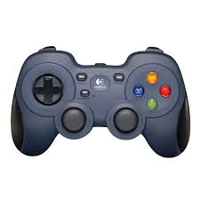
The Gamepad Joysticks
Each gamepad has two joysticks, left and right
Joysticks have two axes, x and y
Each axis is given a name that reflects the gamepad, joystick and axis
double gamepad1.left_stick_x
double gamepad1.left_stick_y
double gamepad2.right_stick_x
…
We can read each axis value individually using that name
Left Joystick
Right
Joystick

Slide 16
Joystick Conventions
Joysticks follow the conventions of computer graphics displays
The x axis increases from left to right, like in mathematics
But the y axis is upside down, it increases from top to bottom, which is the opposite of math
The joystick x and y have a range of -1.0 to +1.0
We can use the values of x and y to compute the direction the driver is telling the robot to go
+1.0
-1.0
x
-1.0
Active
y
Clipped
+1.0

Slide 17
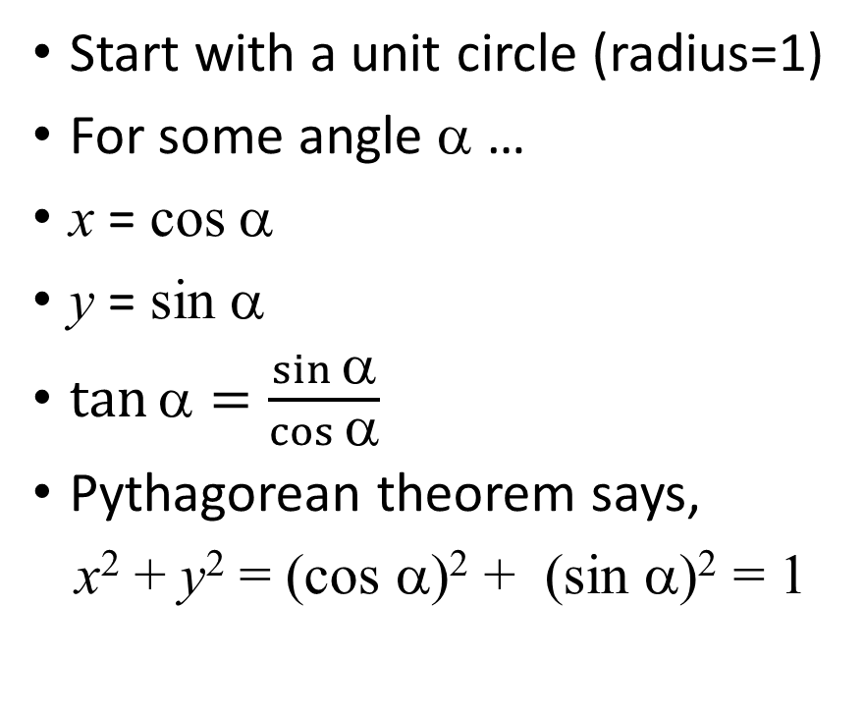
Trigonometry Review
Start with a unit circle (radius=1)
For some angle α …
x = cos α
y = sin α
$\tan{\text{a}}=\frac{\sin{\text{a}}}{\cos{\text{a}}}$
Pythagorean theorem says,
x² + y² = (cos α)² + (sin α)² = 1
+1.0
(cos α, sin α)
y
-1.0
α
+1.0
x
-1.0

Slide 18
The Math.atan2(y, x) function
If you know a point (x, y) on the line, you can find the angle α to the x-axis
α = Math.atan2(y, x)
Notice α is the angle from the x-axis to the line, in radians
We can use this to find the direction the joystick is pointing, but we have to convert α to a bearing, in degrees
+1.0
(x, y)
y
-1.0
α
+1.0
x
-1.0

Slide 19
Comparing α to a Bearing
0°
315°
π/2 (90°)
45°
0°
3π/4 (135°)
π/4 (45°)
315°
45°
270°
90°
α
0 (0°)
90°
270°
π (180°)
bearing
225°
135°
α (deg.)
180°
−3π/4 (-135°)
−π/4 (-45°)
bearing
135°
225°
−π/2 (-90°)
180°

Slide 20
Comparing α to a Bearing
α
Bearing
α is in radians
α is an angle from the x-axis
α increases in a counterclockwise direction
bearing is in degrees
bearing is an angle from the y-axis
bearing increases in a clockwise direction

Slide 21
Converting Between α and a Bearing
x = gamepad1.left_stick_x
y = - gamepad1.left_stick_y
= Math.atan2(y, x)
To get the bearing in degrees
bearing = 90° – 180° * α / π
Math.sin() and Math.cos() need the bearing in radians
radians = π * bearing / 180°

Slide 22
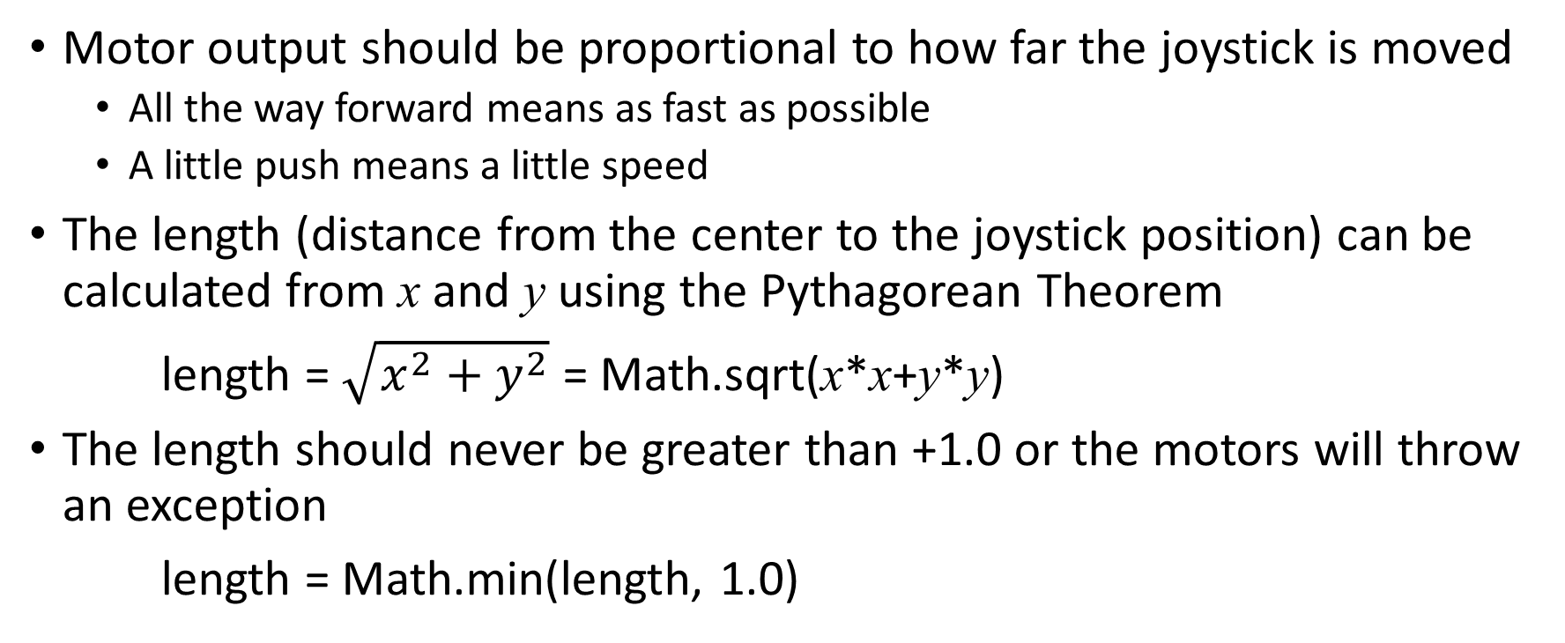
The Final Step
Motor output should be proportional to how far the joystick is moved
All the way forward means as fast as possible
A little push means a little speed
The length (distance from the center to the joystick position) can be calculated from x and y using the Pythagorean Theorem
length = $\sqrt{x^{2}+y^{2}}$ = Math.sqrt(x*x+y*y)
The length should never be greater than +1.0 or the motors will throw an exception
length = Math.min(length, 1.0)

Slide 23
315°
0°
45°
0°
3π/4 (135°)
π/2 (90°)
π/4 (45°)
315°
45°
+1.0
-1.0
x
270°
90°
-1.0
bearing
225°
135°
180°
α
bearing
270°
π (180°)
Active
y
0 (0°)
90°
α (deg.) bearing
x = gamepad1.left_stick_x
y = -gamepad1.left_stick_y
α = Math.atan2(y, x)
bearing = 90° - α * 180°/π
length = √(x²+y²)
speed = min( length, 1.0 )
Clipped
+1.0
−3π/4 (-135°)
−π/2 (-90°)
−π/4 (-45°)
225°
180°
135°

Slide 24
Questions?

